Slide 1
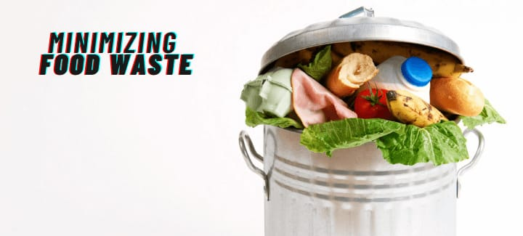
TRACKING OF FOOD WASTE

Slide 2
TEAM MEMBERS
ANUSRI K - 20TUIT008
JANANI B S - 20TUIT030
KAVIYA S - 20TUIT041
GUIDE - Dr . T. RAJESH KUMAR ASP/IT
DOMAIN- ARTIFICIAL INTELLIGENCE

Slide 3
PROBLEM DEFINITION
The problem we see here is of how food around us is wasted, even after having enough food to feed everyone, there's still hunger around us.
The solution we are focusing on is not of the field, but to stop the wastage happening around us.
The proposed scheme is to build an outline which contains general information to tackle similar kinds of problems.
Just by taking a few initiatives we were actually able to reduce the food wastage in our hotels. Our solution is to clearly predict and give data analysis based on the input data , which will help the hotels to reduce or increase their food production.

Slide 4
OBJECTIVE
The problem was clearly evident that most of the food we waste is totally edible and is wasted because we don’t have any other easy option.
We use artificial intelligence to track the daily wastage of food in hotels.
Our objective is to bridge the gap between the individuals who want to donate food and the organizations looking for food in order to help the people who really need them.

Slide 5
LITERATURE SURVEY
PAPER PUBLISHED | AUTHOR | METHODOLOGY
AI based management of Food wastage | Lakshit Sama | kNN(nearest neighbours to k) and SVM(vector support machine) algorithms.
Food waste management innovations in the foodservice industry | Carlos Martin-Rios | Strategic dimensions of waste and radical innovations.
Food Donation management | Gustavsson | Through GPS using application
Sustainable management of food waste | Rod White | Decision Tree

Slide 6
EXISTING SYSTEM
Winnow (@winnowsolutions) is an AI-powered system that's designed to minimize food wastage in restaurant kitchens.
Winnow uses smart technology to track the food being thrown away and generates analytics that is allowing restaurants to see what is being wasted the most and how much money is being lost.

Slide 7
WORKING:
Wasted Food will be thrown away a small scale under the bin is connected to the window tablet using it we can identify the item wasted.
From there cloud based tracking system takes over, it knows the cost and dishes of hotels.
It gives the insight through daily , weekly reporting which helps the hotels to finetune their production.

Slide 8
METHODOLOGY
Our Methodology is to mainly track the food waste in hotels , in this we develop the website and we collect the data’s from user regarding the date, day , name of the dish,number of dishes prepared , number of dishes wasted ,daily which acts the data set. The collected data will be stored in the xampp server .
This data will be passed as Json input to the algorithm.
The algorithm then takes the input and starts predicting the wastage percentage and the production percentage to reduce the food. It will give us the detailed representation regarding the prediction in the form bar chart. From the bar chart the hotel users can choose their necessary production.

Slide 9
While predicting, it will also give the data regarding the percentage of waste food that can be donated to NGO’S. The Hotel users can share the details regarding the food to be donated.
NGOs will raise a request, in case of any leftover food restaurants have. This request is sent to the restaurant manager of that particular restaurant.
The NGO Manager then approves the request and assigns it to one of the NGO employees for takeaway and forwards the request to the restaurant.
The leftover food at the restaurant can be given to NGOs at the end of the day. The admin can track the history of restaurants and NGOs for the leftover foods. This process will continue based on weekly data set and our AI will capture the food waste production continuously.

Slide 10
MODULES
Login Page
Getting input from the hotels
Collecting and storing the details
Implementing own algorithm
Predicting from previous dataset
Suggesting for donation
Display Entire Details

Slide 11
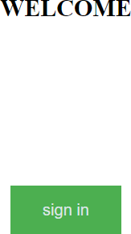
SCREENSHOTS

Slide 12
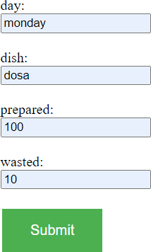

Slide 13
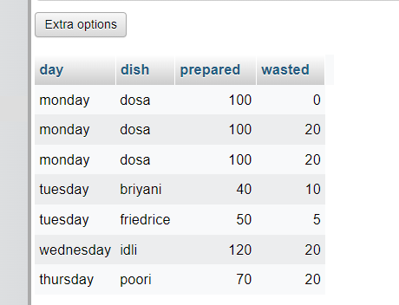

Slide 14
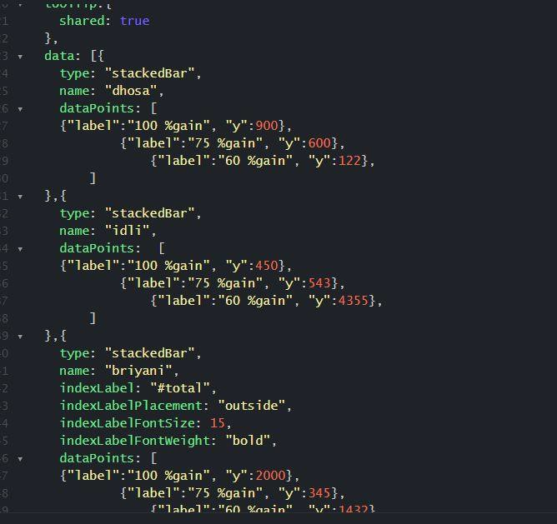

Slide 15
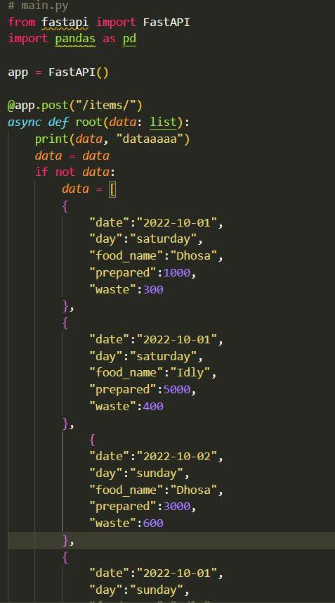

Slide 16
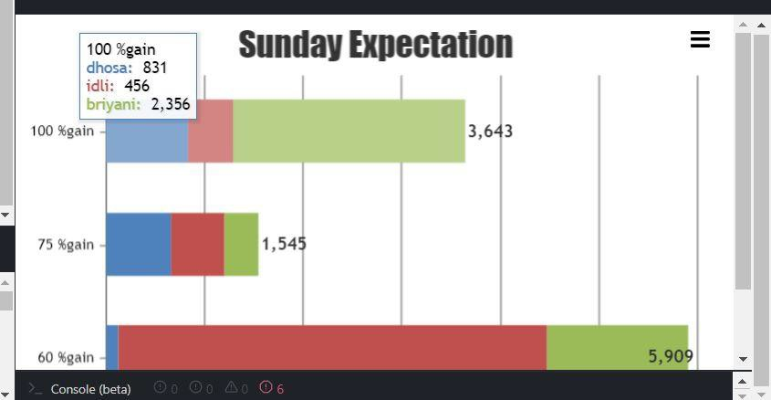

Slide 17
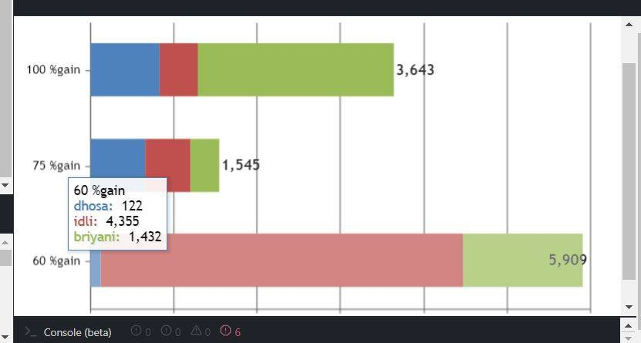

Slide 18
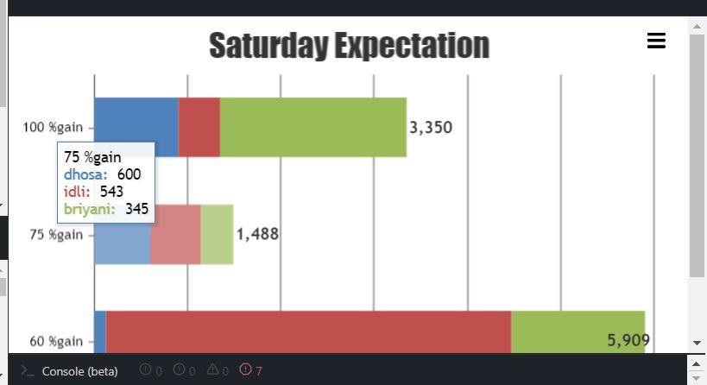

Slide 19
Technology Stack
Front End:
html
php
css
Back End:
Python
Json Server
AI Implementation:
Own Algorithm

Slide 20
EXPECTED OUTPUT
By using Our Smart AI System,
We can reduce the food waste in hotels.
Helping the hotels for the optimized food production.
Simultaneously We help the needy people through volunteers and active organizations by donating the food.
Thus the food waste is reduced in a productive way.

Slide 21
THANK YOU

